Slide 1

RENEWABLES AT THE HEART OF CLEAN COOKING
THE UNITED REPUBLIC OF TANZANIA
MINISTRY OF ENERGY
AT: RENEWABLE ENERGY WEEK 2025
VENUE:JNICC, DSM
DATE: 28TH MAY 2025
BY NOLASCO MLAY

Slide 2
THE IMPLEMENTATION OF THE TANZANIA NATIONAL CLEAN COOKING STRATEGY (2024-2034)
CONTENTS
THE UNITED REPUBLIC OF TANZANIA
AT: EASTERN AFRICA CLEAN COOKING SYMPOSIUM
VENUE: MOUNT MERU HOTEL, ARUSHA
DATE: 6 MAY 2025
Statistics on Clean Cooking
Current Situation in Tanzania
Clean Cooking Championship
Tanzania National Clean Cooking Strategy (2024 – 2034)
Contribution of Renewable energies in Clean Cooking
Ongoing Initiatives (2024/25)
Impact of Ongoing Initiatives
Areas of Collaboration
Conclusion
BY ENG. INNOCENT LUOGA

Slide 3

STATISTICS ON CLEAN COOKING
2.1 billion people worldwide still lack access to clean cooking solutions
990 million people in Sub-Saharan Africa lack access to clean cooking solutions
In Tanzania, only 6.9% of population had access to clean cooking fuels and technologies in 2021, and increased to 15.9% in 2022
Over 3 million people worldwide die prematurely due to indoor air pollution; Women and children together represent over 60% of the total deaths
500,000 - 700,000 premature deaths occur annually in Africa, and 33,024 premature deaths occur annually in Tanzania due to indoor air pollution
These statistics highlight severe environmental, health, and socio-economic impacts, with women and children disproportionately affected

Slide 4

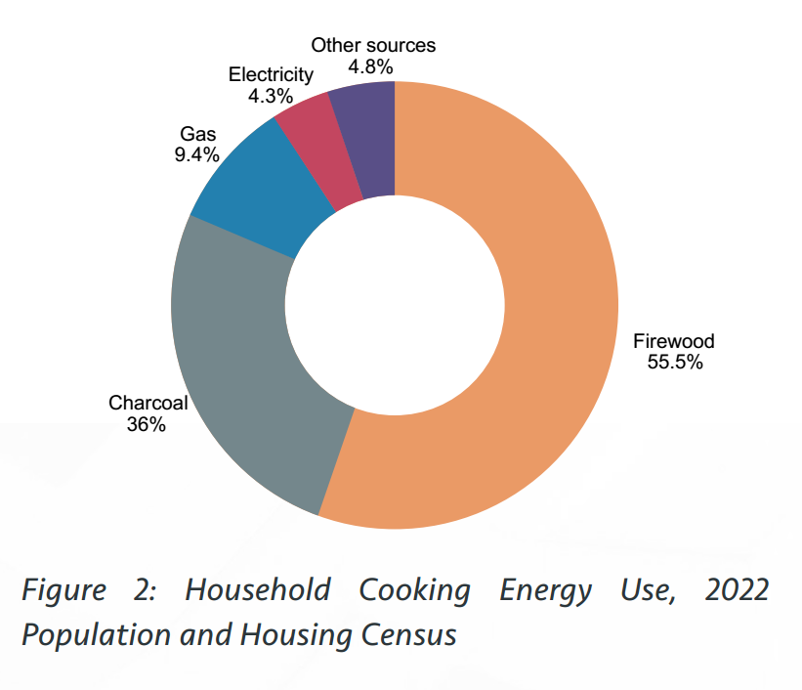
CURRENT SITUATION IN TANZANIA
4.9%
4.2%
9.1%
56%
25.8%
Household Cooking Energy Use, 2022 Population and Housing Census

Slide 5

CLEAN COOKING CHAMPIONSHIP
Her Excellency Dr. Samia Suluhu Hassan, President of the United Republic of Tanzania is championing the clean cooking agenda as a gender-responsive just energy transition approach through the African Women Clean Cooking Support Programme (AWCCSP), launched at COP28 in December 2023.
In Tanzania, this movement began in November 2022 when she directed the creation of a 10-year roadmap to reduce the use of traditional cooking methods

Slide 6
CLEAN COOKING CHAMPIONSHIP…
SUMMIT ON CLEAN COOKING IN AFRICA (May 2024): H.E. Dr. Samia Suluhu Hassan, President of United Republic of Tanzania, co-chaired with H.E. Jonas Gahr Støre, Prime Minister Norway, Dr. Akinwumi Adesina, President of African Development Bank Group, and Dr. Fatih Birol, Executive Director of the International Energy Agency (IEA). A total of 2.2 billion USD was mobilised in financial pledges to accelerate clean cooking in Africa.
G20 SUMMIT (November 2024): H.E. Dr. Samia Suluhu Hassan, President of United Republic of Tanzania, championed clean cooking and it merged as declaration No. 53 in the G20 Rio de Janeiro Leaders’ Declaration.
COP29 (November 2024): H.E. Dr. Philip Isdor Mpango, Vice President of the United Republic of Tanzania chaired a High-level side event on Addressing Clean Cooking Challenges in Africa: A Call for African Leadership. It highlighted the urgent need for political leadership, innovative partnerships, and substantial financial investment to achieve sustainable, clean cooking solutions across Africa.

Slide 7

CLEAN COOKING CHAMPIONSHIP…
AFRICAN HEADS OF STATE ENERGY SUMMIT (January 2025): H.E. Dr. Samia Suluhu Hassan, President of United Republic of Tanzania hosted the Mission300 Summit and launched the Tanzania National Energy Compact. It targets a 75% clean cooking access by 2030, complementing the implementation of the Tanzania National Clean Cooking Strategy (2024 – 2034) which aims to achieve an 80% clean cooking access by 2034.

Slide 8

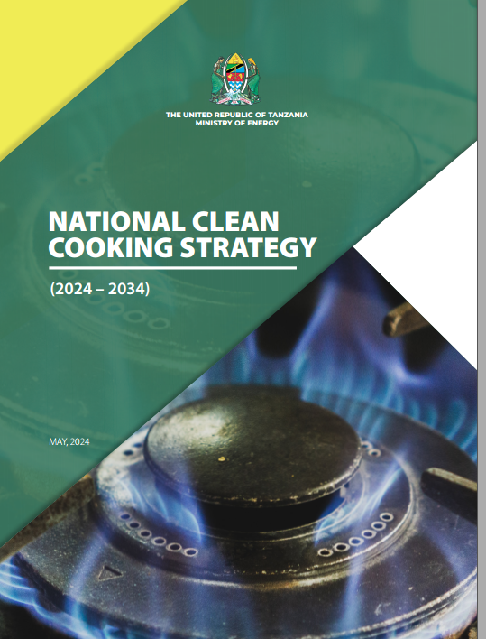
TANZANIA NATIONAL CLEAN COOKING STRATEGY (2024 - 2034)
The Government of the United Republic of Tanzania in collaboration with various stakeholders has developed and is implementing the National Clean Cooking Strategy (2024 - 2034)
The Objective is to ensure 80% of Tanzanians have access to clean cooking solutions by 2034
The Strategy was launched on 8th May 2024 by Her Excellency Dr. Samia Suluhu Hassan, President of the United Republic of Tanzania

Slide 9
TANZANIA NATIONAL CLEAN COOKING STRATEGY (2024 - 2034)...
The Strategy has the following Specific Objectives:
Increase public and institutional awareness on the importance of using clean cooking solutions.
Ensure the accessibility of raw materials and reliable infrastructure for clean cooking solutions.
Reduce the cost of clean cooking energy, appliances and efficient cooking stoves.
Develop, update and harmonize enabling Policies, Laws, Regulations and Guidelines to facilitate the adoption of clean cooking solutions.

Slide 10
TANZANIA NATIONAL CLEAN COOKING STRATEGY (2024 - 2034)...
Promote investments in the clean cooking sub-sector.
Broaden the scope of research and innovations in technologies related to cooking solutions.
Build the capacity of implementers in clean cooking projects.
Incorporate HIV/AIDS, Gender and Good Governance in clean cooking.

Slide 11
CONTRIBUTION OF RENEWABLE ENERGY IN CLEAN COOKING
Tanzania is privileged to have a plenty of renewable energies which can greatly contribute to the accessibility of clean cooking solutions.
The renewable energies that could contribute to clean cooking solutions in Tanzania are like Biomass, Hydro, Wind, Biogas, Natural Gas, Solar, Bioethanol, Geothermal etc.
These renewable energies can be directly or indirectly converted to clean cooking solutions.
They can either be directly converted to heat energy for cooking or rather they can be used to generate electricity which in turn can be a cooking fuel.

Slide 12
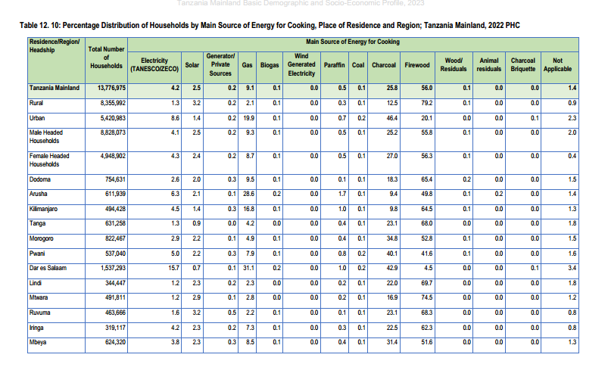
CONTRIBUTION OF RENEWABLE ENERGY IN CLEAN COOKING…

Slide 13

ONGOING INITIATIVES (2024/25)
Distribution of 200,000 subsidized improved cookstoves
Distribution of 452,445 subsidized LPG cylinders
Connection of natural gas to 980 (Lindi – 451 and Coastal region- 529) households
Supporting institutions such as 129 prisons to transition to clean cooking.
Supporting clean cooking SMEs (EU-funded Programme)
Distribution of subsidized machines for briquettes production
National and international awareness programs
Development of National Clean Cooking Communication Strategy

Slide 14
ONGOING INITIATIVES (2024/25)...
Development of National Clean Cooking Database
Clean Cooking baseline survey
Development of a national clean cooking fund
Capacity building programs
Infrastructure development
Development of Minimum Energy Performance Standards (MEPS) for Clean cooking stoves and appliances
eCooking training and curriculum development for technicians
Formation of a dedicated clean cooking unit
Tax exemptions or reductions on clean cooking

Slide 15
AREAS OF COLLABORATION
Construction of infrastructure for producing, receiving, storing, and distributing clean cooking energy
LPG receiving and storage facilities
Natural gas distribution infrastructure in Mtwara, Lindi, Pwani, Dar-es-Salaam and neighbouring regions (City gas networks, small scale LNG distribution, CNG stations)
LPG/Natural gas accessories and cylinders production/assembly plants
Biogas and Bioethanol production plants
Improved Cookstoves production workshops
eCooking and solar stoves production/assembly plants

Slide 16
AREAS OF COLLABORATION…
Construction of clean cooking facilities in 31,395 public institutions feeding more than 100 people per day (following implementation of the Ban on the use of firewood and charcoal for cooking in institutions in Tanzania by January 2024).
3. Public and institutional awareness programs on the importance of using clean cooking solutions.
4. Research, innovations and technological transfer related to cooking solutions.
5.Capacity Building programs.
6. Carbon financing.

Slide 17
CONCLUSION
Tanzania has significant supplies of renewable energy resources;
Clean cooking energy demand is rising sharply, and therefore deliberate efforts to address the trend are on-going;
Several investment opportunities exist in clean cooking for private sector participation;
The Government of URT is fully committed and will continue to expedite implementation of priority clean cooking energy projects and attract private investments;
The Government of URT will continue to maintain its social & political stability.

Slide 18

“Tumtue Mama
Kuni Kichwani”
THE UNITED REPUBLIC OF TANZANIA
Let's Relieve Mothers from Carrying Firewood
Her Excellency Dr. Samia Suluhu Hassan
President of the United Republic of Tanzania
01 November 2022

